Slide 1
Data-Driven Discount Strategy for Eniac
Are Discounts Beneficial?
Group 2: Asli Özdemir Strollo, Azumi Sifau Muhammed, Carlos Victor Montefusco Pereira, Olaf Bulas

Slide 2
The Discount Debate
Marketing Team Lead
"Discounts drive customer acquisition, satisfaction, retention, and growth."
Board of Investors
"Increased orders, decreased revenue. Focus on quality over low prices."
Is there a clear winner in this debate? Let's delve into the facts.

Slide 3
Eniac Dataset
Orders
Orderlines
Products
Brands

Slide 4

Data Collection Improvements
Problems with the data tables:
Wrong data types for prices and dates
Big amount of product duplicates
Price Data Issues with decimal places and points
Data Redundancy in all tables
Outdated and unnecessary data
For more details ask our team and look into the slides in the appendix

Slide 5
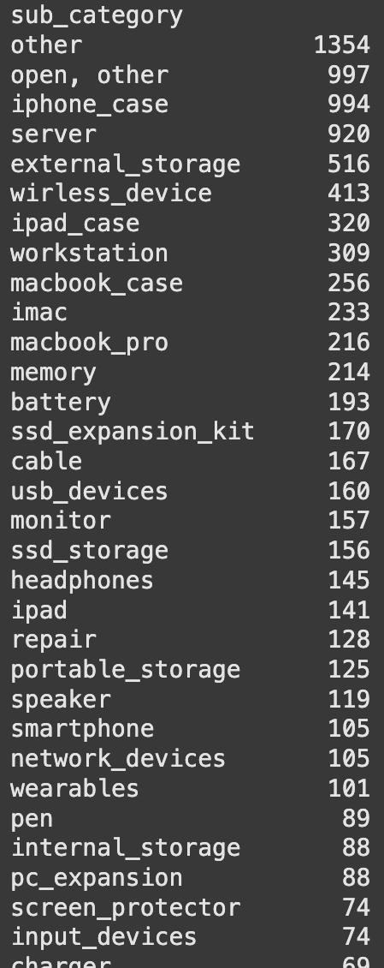
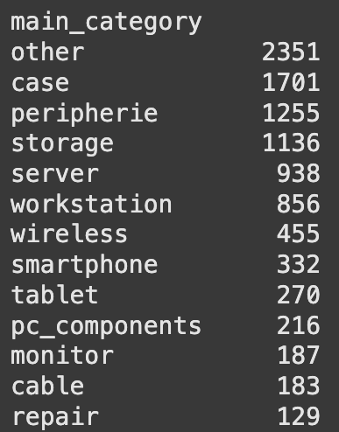
Product Categorization
Easier understanding, simpler analysis & reporting.
Over 76% of products already categorized!

Slide 6
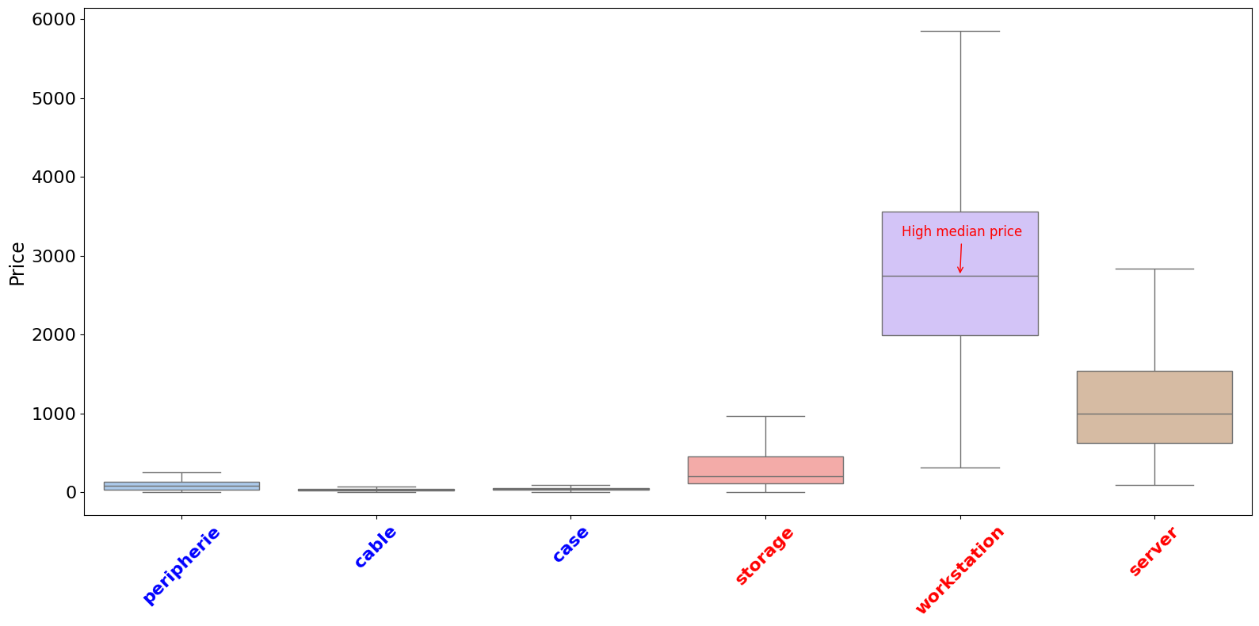
Price Distribution Across Categories
"Categories" - >
High price range
Product tiers: Strategic discount
"Categories" ->
Low price range
Aggressive discounts can eat up all profit

Slide 7
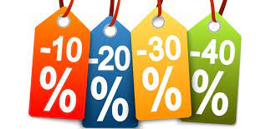
95%
of all products sold were discounted.
Discounting was the norm, not the exception

Slide 8
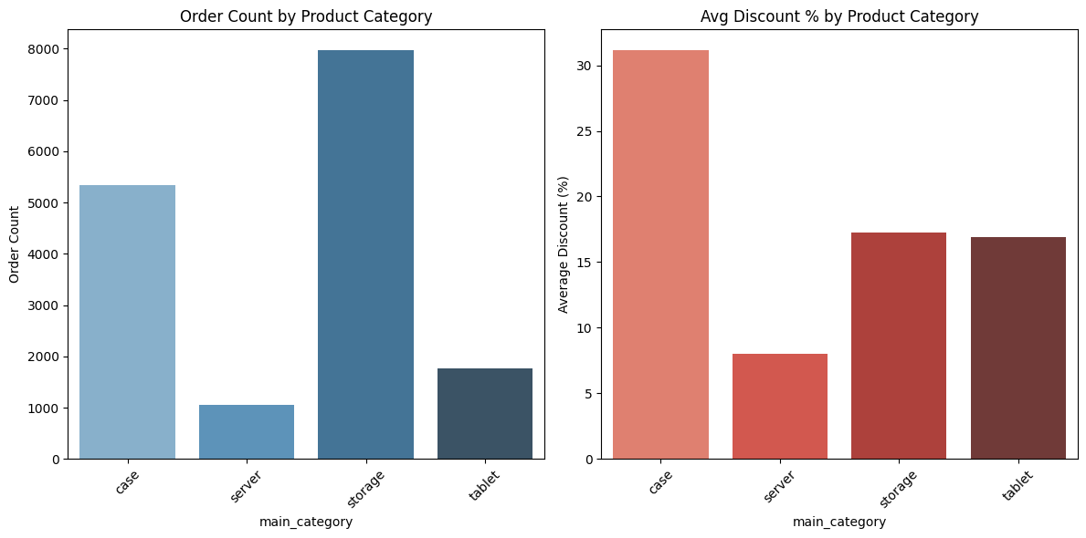
Discounts Don't Drive Order Volume

Slide 9
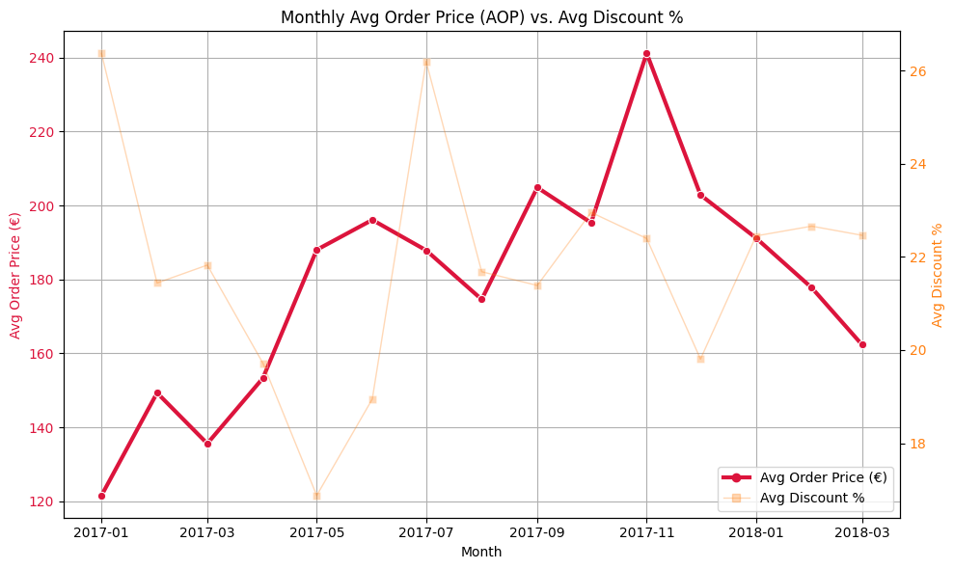
Do Discounts And Special Days Drive AOP Peaks/Drops?
Avg Order Price = Revenue / Number of Orders

Slide 10
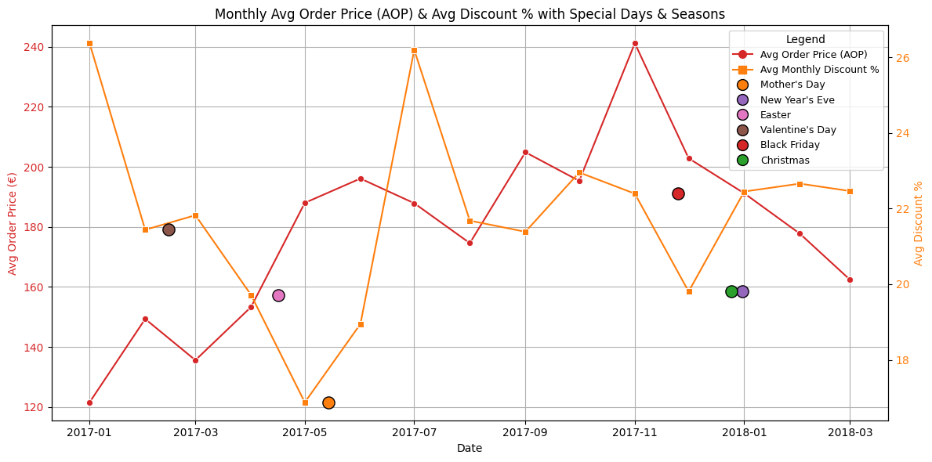
Discounts Have Little AOP Impact

Slide 11
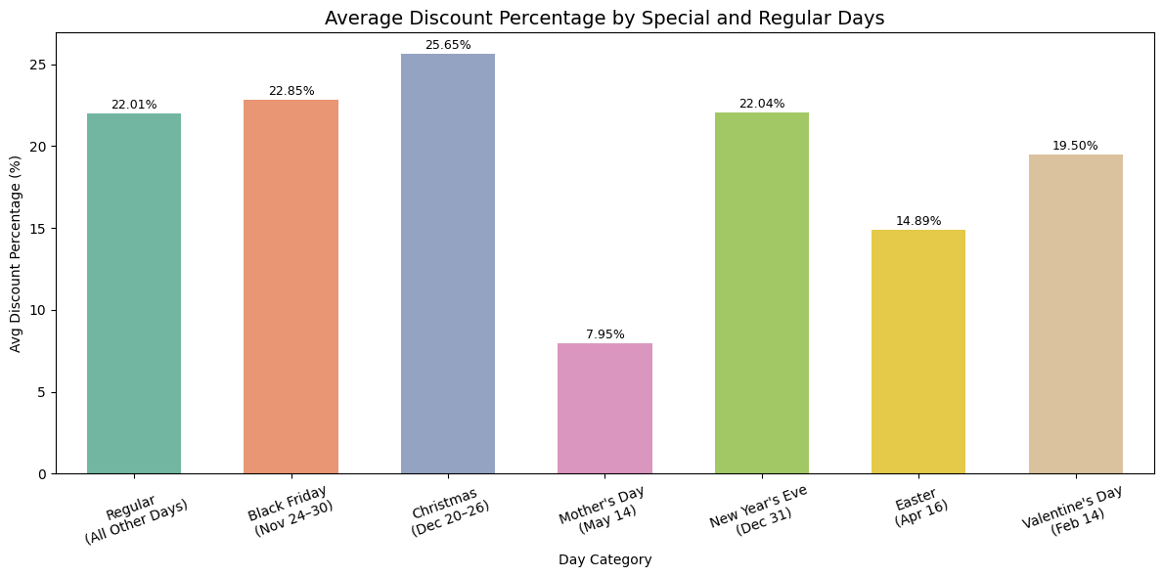
Discount Behavior on Special and Regular Days

Slide 12
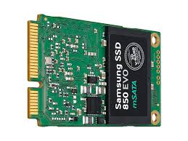
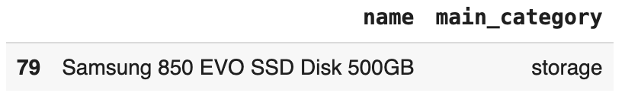
The most sold product over time: Samsung SSD
It was sold 328 times with 40 different prices over time
How effective were the discounts on the sales of this product?

Slide 13
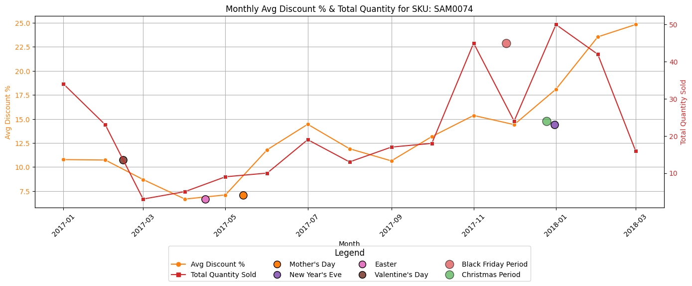
Some special days drive sales more than discounts.

Slide 14
Recommendation
We support the board of investors' decision to avoid frequent, aggressive discounts. Our data indicates that such discounts rarely boost sales and often lead to lower revenue. Instead, our company's strength lies in direct customer contact, which builds higher retention and growth through quality, not low prices.

Slide 15
Sources & Appendix
Detailed slides on data collection enhancements are up next.
Sources:
Slide 4 - Image Source Slide 6 - Image Source

Slide 16
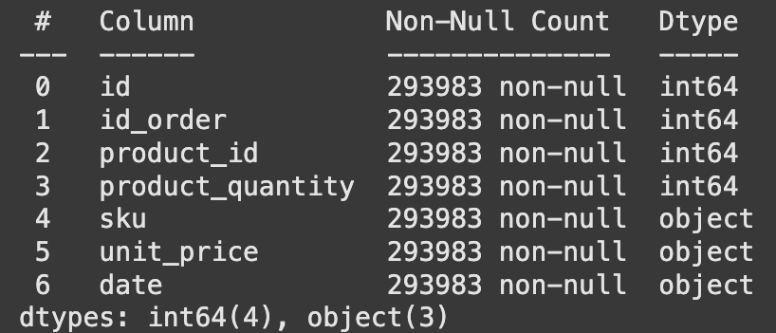
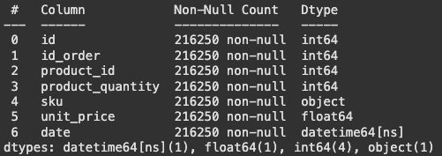
Data Collection Improvements - Data Types
Prices = object
Dates = object
Using strings for prices and dates won’t allow us to analyse the data accordingly
Prices = numeric
Dates = datetime
Changes made to data types in 3 / 4 of the tables

Slide 17
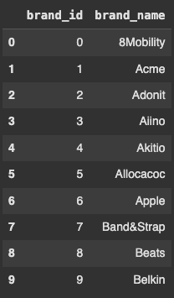
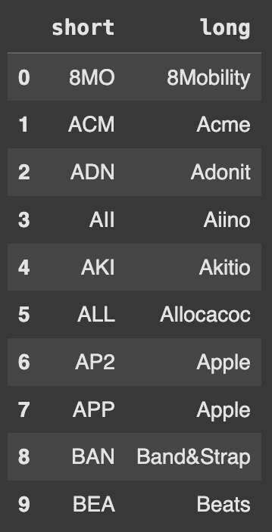
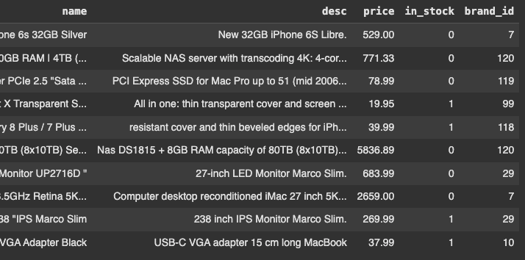
DCI - Brands Table
Brands
Solution:
Remove short column
Rename long column
Remove duplicates from the brand_name column
Adding a dedicated primary key
Problem:
Short key is reliant on the SKU structure.
Data redundancy with brands appearing multiple times in long column.
Solution:
Remove short column
Rename long column
Remove duplicates from the brand_name column
Adding a dedicated primary key,
Add brand_id as a foreign key to the products table.

Slide 18
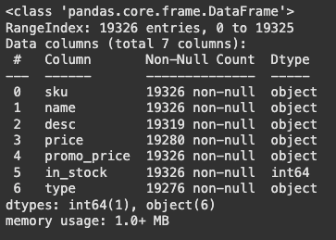
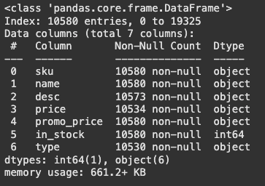
DCI - Products Duplicates
Products
We had 8746 duplicates in the products table. 45% of all products!
Add a input validation check to save storage and get a better overview

Slide 19
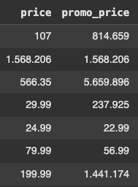
DCI - Price Data Issues & Solution
Products
92% of promo prices used incorrect formats like multiple decimal points and more than two decimal places
Implement a 'float' data type for prices to prevent multiple decimal points.
Add an input validation check to reject prices with more than two decimal places and trigger an error.

Slide 20
DCI - Shopping Cart
Shopping Cart
Problem: Current system uses Orderlines table for temporary "Shopping Basket" items, leading to old data like carts from 2017
Solution: Create a Shopping Cart table
Purpose: Stores temporary items (add, remove, adjust quantity) before an order is finalized.
Orderlines
Shopping Cart

Slide 21
DCI - Promotions
Promotions
Remove promotion_price from Products table and create a Promotions table
Avoids Redundancy: No need to update every product when promotions changes.
Flexibility: Allows dynamic, time-sensitive, and complex promotion rules.
Single Source of Truth: Promotions table centrally manages all promotion logic.
Orderlines
Shopping Cart
Promotions

Slide 22
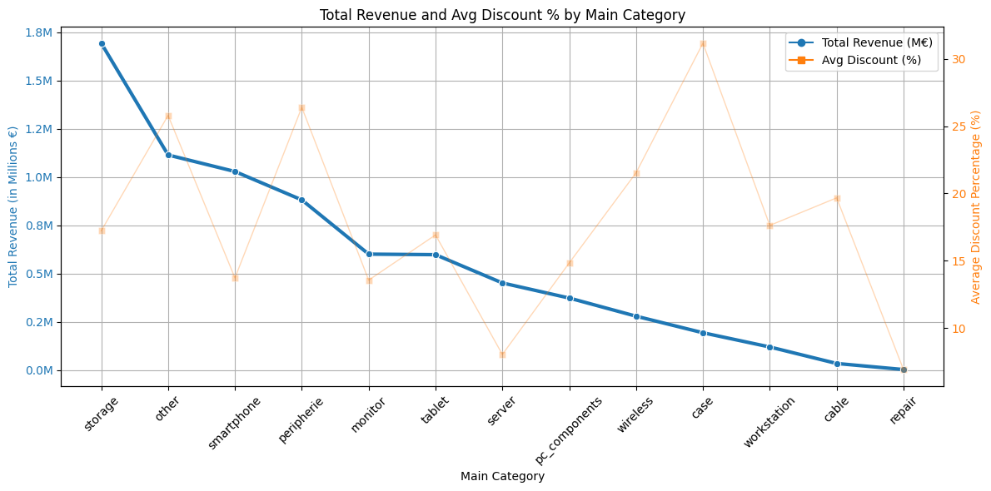
Discounts are ineffective due to consistently low prices

Slide 23
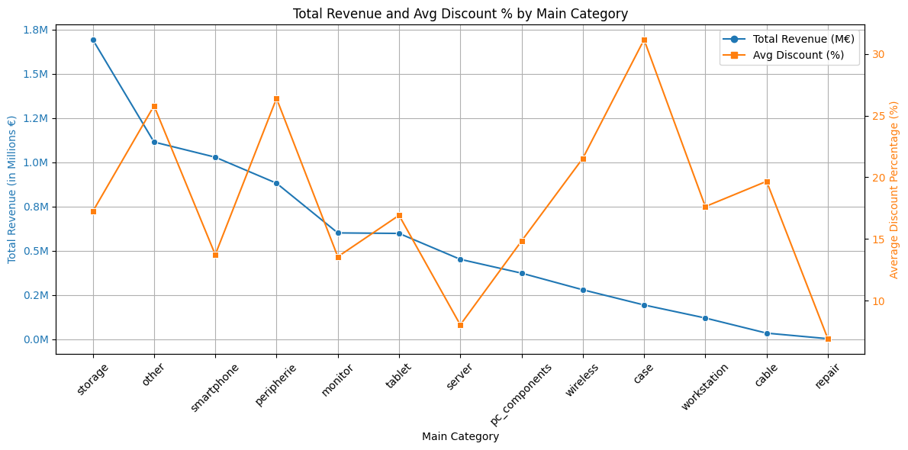
Total revenue doesn’t seem to depend much on discounts, regardless of price level.

